Slide 1

2020 Annual Review

Slide 2
CONTENTS
1
2019 & 2020 Contracts Review
2
Cognizant AMS Scope and Pipeline
3
Cognizant AMS 2020 Delivery Review
AMS Team Structure and Finance

Slide 3
2018 Service Procurement Summary
No. |  | Contract Name | Start Date | End Date | Amount with Tax | PM | Execution Status | Status
1 |  | AMS | 2018/1/1 | 2018/12/31 | 5,136,323.28 | Jacky Gao | ● | Complete
2 |  | AMS – AV/CDR | 2018/7/1 | 2018/12/31 | 207,018 | Jacky Gao | ● | Complete
4 |  | Content Author 2018 | 2018/1/1 | 2018/8/30 | 251,872 | Cao Wei | ● | Complete
5 |  | CR1700780开发 | 2017/12/31 | 2018/3/31 | 44,000 | Jiang Wei | ● | Complete
6 |  | MDES CR1600999 & CR1700352 | 2108/3/15 | 2018/4/30 | 31,800 | Jiang Wei | ● | Complete
7 |  | CR1800450开发 | 2018/8/31 | 2018/9/28 | 30,000 | Zhibing Xu | ● | Complete
8 |  | StructuredEnhancement-Wechat-CR170030 | 2017/9/1 | 2017/12/31 | 321,200 | Cindy Li | ● | Complete
Total（RMB） |  |  |  |  | 6,022,213.18
CR
● On track ● At risk ● Behind

Slide 4
2019 Service Procurement Summary
No. |  | Contract Name | Start Date | End Date | Amount with Tax | PM | Execution Status | Status
1 |  | AMS – OBS | 2019/1/1 | 2019/12/31 | 4,613,687.03 | Jacky Gao | ● | On-going
2 |  | AMS – CBS | 2019/1/1 | 2019/12/31 | 1,621,886.68 | Jacky Gao | ● | On-going
3 |  | CR1700922 One Quotation系统安全漏洞修复 | 2018/9/1 | 2019/5/27 | 93,000 | Zhenguo Jin | ● | Complete
Total（RMB） |  |  |  |  | 6,328,573.71
● On track ● At risk ● Behind

Slide 5
AMS current scope
AMS China Engagement kick started in Oct 2014 and entered into steady state in Q1 2015. The scope is to do Application maintenance support for 40 applications spanning across various technologies. The scope was updated in June 2020 as Cognizant won RFP for new scope.
AMS China – Key Business Area
Audit
Agent Management
Doc Management
IT Support
Communication
CIRC
e-opening
iMap
FileNet
New Printing
Scanning
JIRA
EMAIL
SMS
Policy Management
Customer Service
Reporting
AURA
PASS
MDES
WTS
WeChat
DHT
eClaim
eNotice
CSO
CIRC
SMIS
SAP BO
Sales
Enterprise wechat
Data Warehouse
MTS
One Quotation
Web Portal
DTC(SWAN)
BMP
RPIS
EZT
Gonghui
Xiehui
RI-ETL
ODS
DM/TM BI
AMS China – Key Technologies
Java / .NET / WeChat / SAP-BO / Informatica / Cognos/ Angular / H5 / CSS3 /IOS / Andriod

Slide 6
Scope in-take of 2020 & Transition Pipeline
1. Cognizant AMS added the below scope in 2020:
RPIS
EZT
ARS
BMP
EB-WECHAT
2. Scope won in JUNE 2020 :
RPIS
EZT
ARS
BMP
EB-WECHAT
3. Additional scope suggestion:
2020-2021 Pipeline: QA Automation, Treasure Management Platform, Fee Management System, NB Workflow
To-be-determined: New Comp, Data Lake,中保信保单报送平台,IVR-TM,IVR-CS, i-Pay, iPartner

Slide 7

TIM 补充
Key Highlight - 2020
No. | Application System | Description | Benefit
1 | All | Cognizant takes over AMS metrics reports for all vendors. Metrics include monthly ticket reports, SLA, etc. Cognizant team worked as liaison to manage other AMS vendor teams. | Additional contribution by Cognizant team to bring forward centralized reporting.
2 | ODS | ODS has a major change in Sep. The new environment is ODS backend database(SQLServer) which use solid state disk and has much more storage space, also the version is upgraded from 2008 to 2012, what we did is smooth code migration and performance comparison, avoid any impact of data pushing to downstream. | System performance is greatly improved.
3 | CIRC Reporting | Data model for CIRC Reporting failed to produce the required report for March. ODS engineers and CIRC engineers have worked together through over-time to optimize the data model and produced the reports timely. | Performance gain of monthly CIRC database reporting. Permanent fix of the issue. Estimated 0.2 FTE per month saving.
4 | iMap | Updated iOS certificate for MetLife China, so that all iOS systems can receive updated certificate, including iMap. Fixed historical issue of image overlay. 525365 policies scanned and fixed 1717 problematic policies. | iOS certificate is universally updated for all MetLife China iOS App’s. Estimated one time effort saving of 1 person month for automated image fixing.

Slide 8
Feedback and Improvement Plan
Feedback | Improvement Plan
Tim 写上发布流程
The high load of the system may lead to system downtime. If the problem cannot be found and handled, it will bring huge production accidents | Cogniznt AMS team has been working on using the current popular technology to develop application service monitoring application system, discover application problems in time and inform relevant personnel to handle them in time, which improves efficiency and reduces risk Cognizant team is to onboard internal Delivery Excellence team to help with process maturity and annual assessment.
TIM 完成

Slide 9
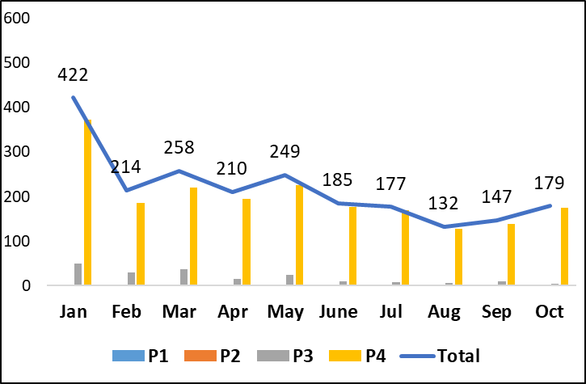
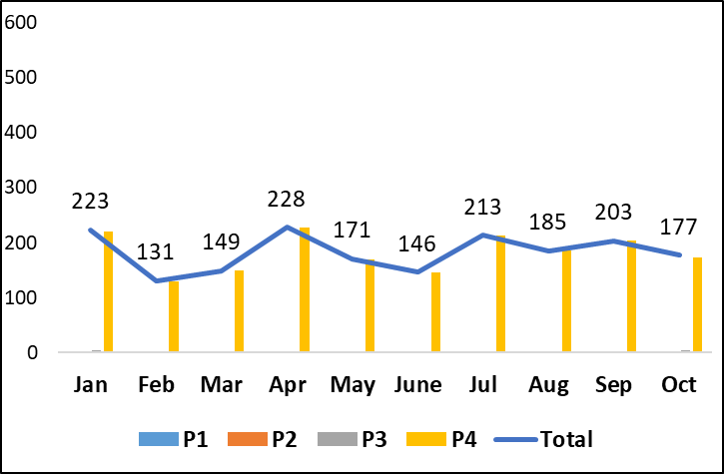
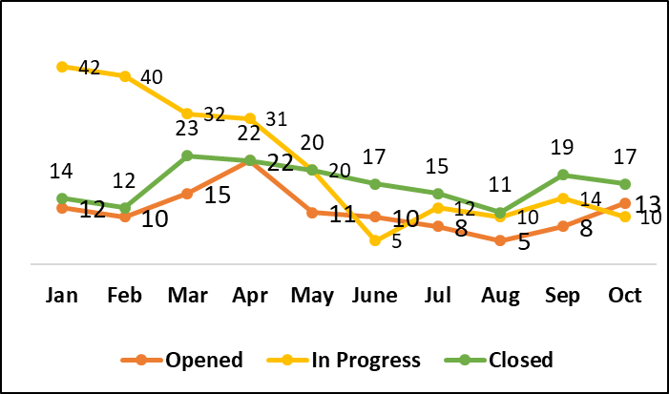
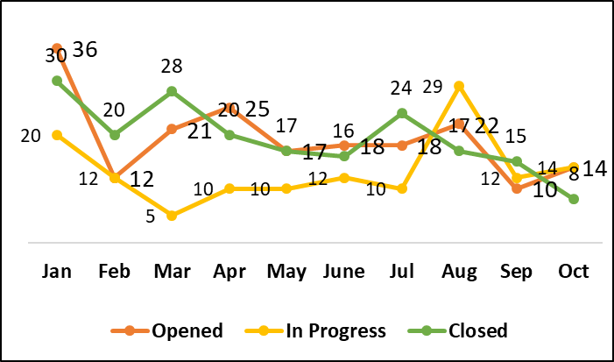
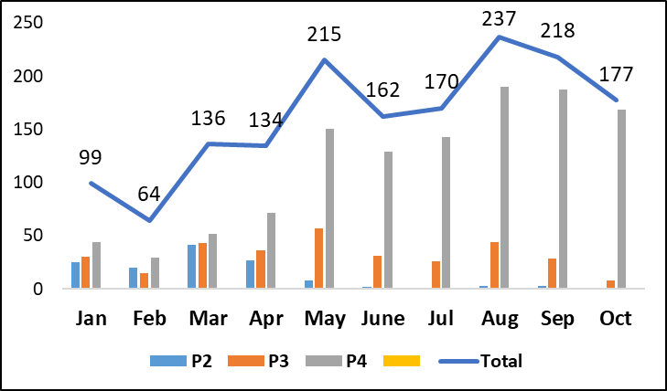
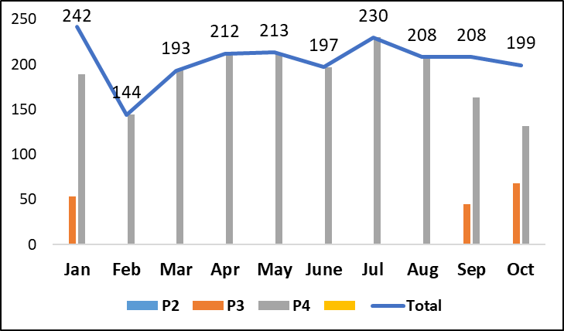
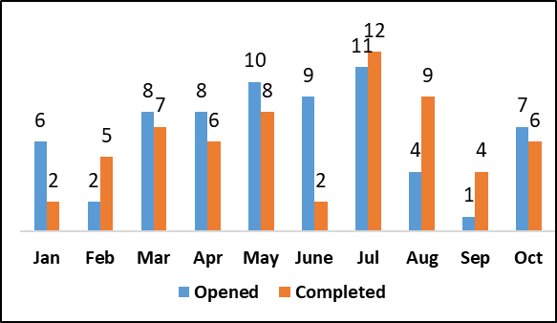
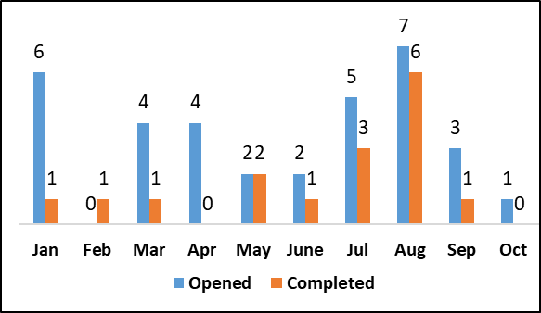
Delivery Snapshot
IM Ticket Trend – Aug-Dec 2019
IM Ticket Trend – Jan-May 2020
Problem Ticket Trend - Aug-Dec 2019
Problem Ticket Trend - Jan-May 2020
16% decrease in incident trend when compared from 2018(Average of 217) to current 2019(Average of 183)
Majority of the tickets from PASS , Wechat and MTS.
Problem tickets incoming rate has increased in 2019 compared to 2018.
SR Ticket Trend – Aug-Dec 2019
SR Ticket Trend – Jan-May 2020
WR trend – Prior – Aug-Dec 2019
WR trend – Prior Jan-May 2020
27% Increase in SR trend when compared to 2018(Average of 161) to current 2019(average of 205).
CR intake and closure trend slightly reduced as more focus on application stabilization improvements

Slide 10
SLA Dashboard
SLA Metrics | Severity | Expected SLA | SLA | Jun’19 | Jul’19 | Aug’19 | Sep’19 | Oct’19 | Nov’19 | Dec’19 | Jan’20 | Feb’20 | Mar’20 | Apr’20 | May’20
INC-Response time | P1 | 95% | 15 min | NA | NA | NA | NA | NA | NA | NA | NA | NA | NA | NA | NA
 | P2 | 95% | 30 min | NA | 100% | NA | NA | NA | NA | NA | NA | NA | NA | NA | NA
 | P3 | 90% | 1 hr | 100% | NA | NA | NA | 100% | 98% | 98% | 100% | NA | 100% | NA | NA
 | P4 | 90% | 2 hrs | 97% | 93% | 97% | 98% | 100% | 96% | 100% | 100% | 98.08% | 97.83% | 98.5% | 97%
INC-Resolution Time | P1 | 100% | 2 hrs | NA | NA | NA | NA | NA | NA | NA | NA | NA | NA | NA | NA
 | P2 | 91% | 3 hrs | NA | 100% | NA | NA | 100% | 100% | NA | NA | NA | NA | NA | NA
 | P3 | 91% | 6 hrs | 100% | NA | NA | 100% | 100% | 96% | NA | 93.33 | NA | 100% | 100% | NA
 | P4 | 91% | 8 hrs | 96% | 97% | 91% | 96% | 97% | 100% | 98.2% | 96.67% | 96.72% | 100% | 100% | 100%
SR-Response time | P2 | 95% | 30 min | NA | NA | NA | NA | 100% | 100% | NA | NA | NA | NA | NA | NA
 | P3 | 90% | 1 hr | NA | NA | NA | 100% | 100% | 100% | 100% | 100% | 100% | NA | NA | NA
 | P4 | 90% | 2 hrs | 90% | 93% | 95% | 95% | 100% | 100% | 100% | 100% | 100% | 90% | 95% | 97%
SR-Resolution Time | P2 | 91% | 1 BD | NA | NA | NA | NA | 100% | 100% | NA | NA | NA | NA | NA | NA
 | P3 | 91% | 3 BD | 100% | 100% | 100% | 94% | 93% | 91% | 92.65% | 95.31% | 88.64% | 100% | 100% | NA
 | P4 | 91% | 5 BD | 100% | 100% | 100% | 99% | 93% | 95% | 96.45% | 94.85% | 93.9% | 99.1% | 99.26% | 100%
SLA Analysis:
SLA has been all green for year 2019 with MetLife China unified SLA report.

Slide 11


